Slide 1
Lexical Analyzer
(Part 2)

Slide 2
Attributes of Tokens
Lexical analyzer
y := 31 + 28*x
<id, “y”> <assign, > <num, 31> <+, > <num, 28> <*, > <id, “x”>
token
tokenval (token attribute)
Parser

Slide 3
Tokens, Patterns, and Lexemes
A token is a classification of lexical units
For example: id and num
Lexemes are the specific character strings that make up a token
For example: abc and 123
Patterns are rules describing the set of lexemes belonging to a token
For example: “letter followed by letters and digits” and “non-empty sequence of digits”

Slide 4
SCANNER
It is the only part of the compiler which reads a complete program.
It takes about 25-30% of the compiler’s time.
Usually it uses look ahead with double buffering technique to minimize the overhead.
Lexical analysis needs to look ahead several characters before a pattern is matched.
There are two buffer input schemes for look ahead:
Buffer Pairs
Sentinels

Slide 5
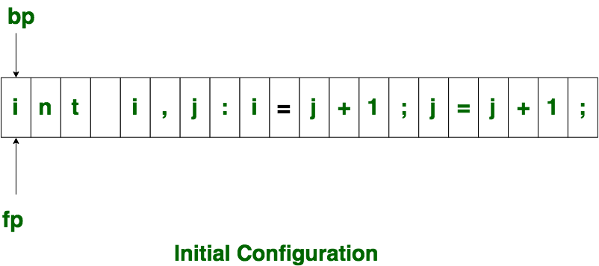
Input buffering
A buffer contains data that is stored for a short amount of time, typically in the computer’s memory (RAM).
The purpose of a buffer is to hold data right before it is used.

Slide 6
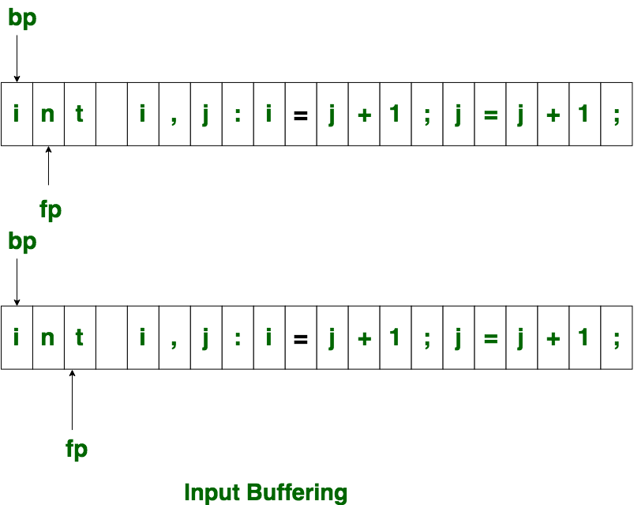
Input buffering (contd.)
Initially both the pointers point to the first character of the input string as shown below
The forward ptr moves ahead to search for end of lexeme. As soon as the blank space is encountered, it indicates end of lexeme. In above example as soon as ptr (fp) encounters a blank space the lexeme “int” is identified.
The fp will be moved ahead at white space, when fp encounters white space, it ignore and moves ahead. then both the begin ptr(bp) and forward ptr(fp) are set at next token.
Note: According to your textbook, bp and fp represent lexemebeginning and forward respectively.

Slide 7
Input buffering (contd.)
The input character is thus read from secondary storage, but reading in this way from secondary storage is costly. hence buffering technique is used.
A block of data is first read into a buffer, and then second by lexical analyzer.
There are two methods used in this context:
One Buffer Scheme, and
Two Buffer Scheme.

Slide 8
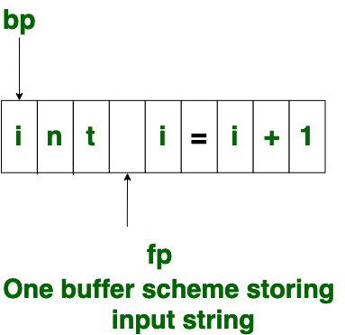
One buffer scheme
In this scheme, only one buffer is used to store the input string.
However, the problem with this scheme is :
if lexeme is very long then it crosses the buffer boundary, to scan rest of the lexeme the buffer has to be refilled, that makes overwriting the first of lexeme.

Slide 9
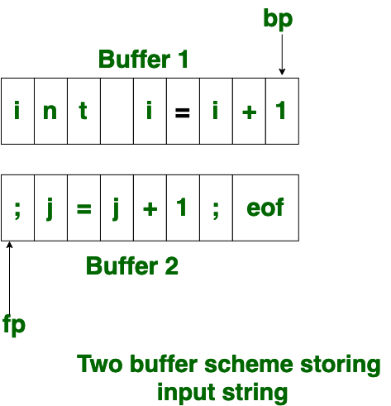
Two Buffer scheme
To overcome the problem of one buffer scheme, in this method two buffers are used to store the input string.
the first buffer and second buffer are scanned alternately.
when end of current buffer is reached the other buffer is filled.
The only problem with this method is:
if length of the lexeme is longer than length of the buffer then scanning input cannot be scanned completely.

Slide 10
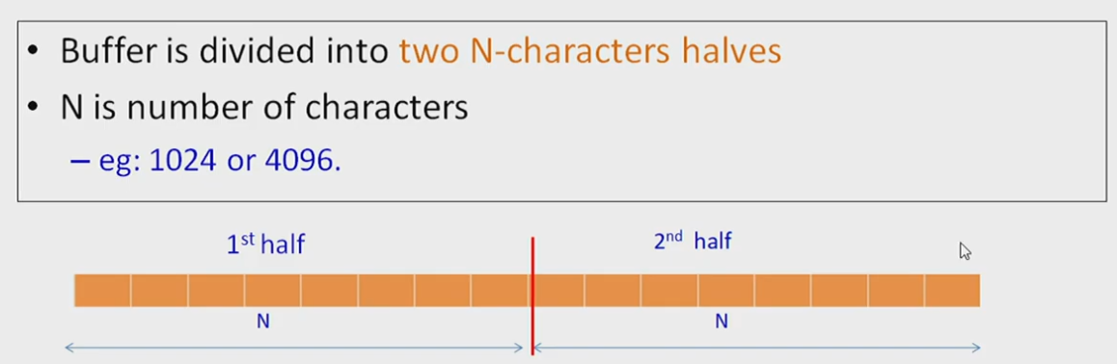
Buffer pairs

Slide 11
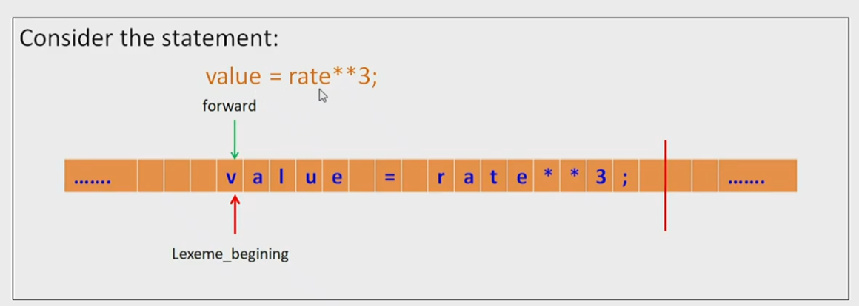
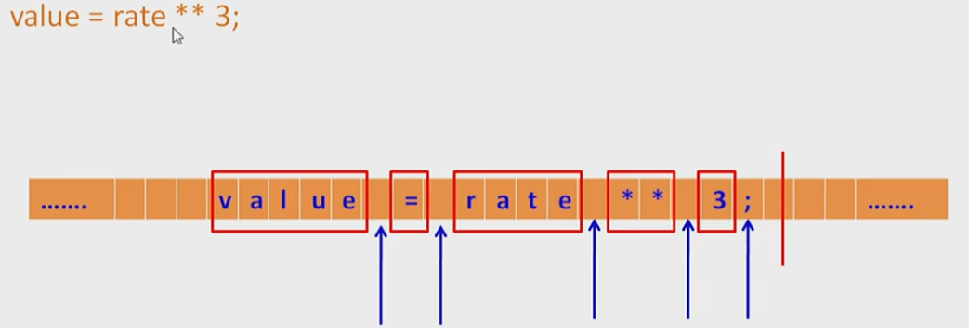
Separators

Slide 12
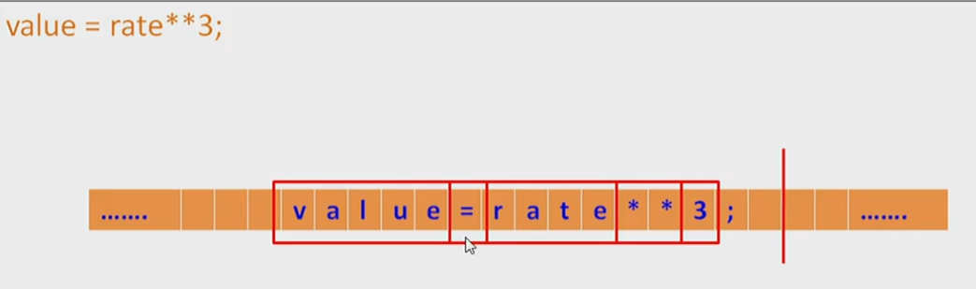
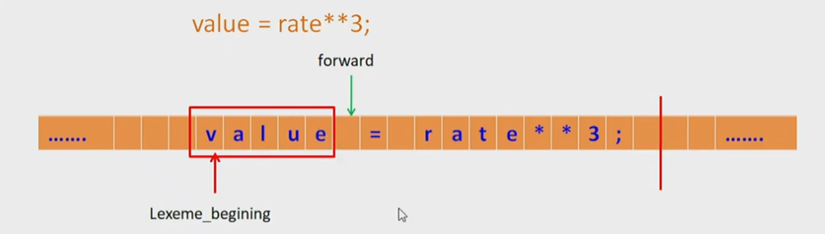
Buffer pairs (contd.)

Slide 13
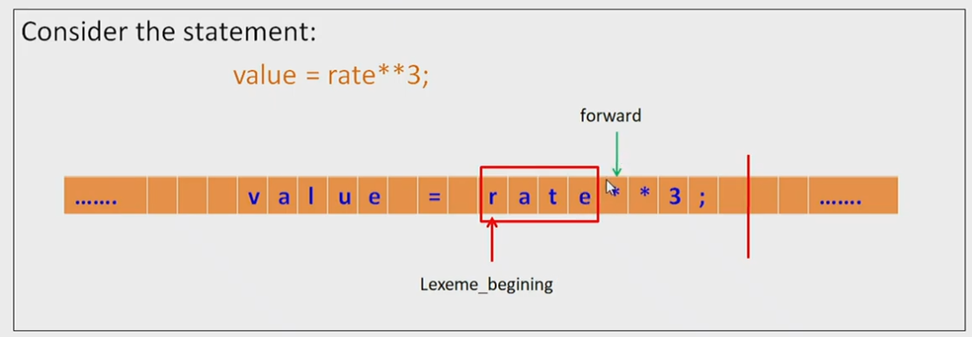
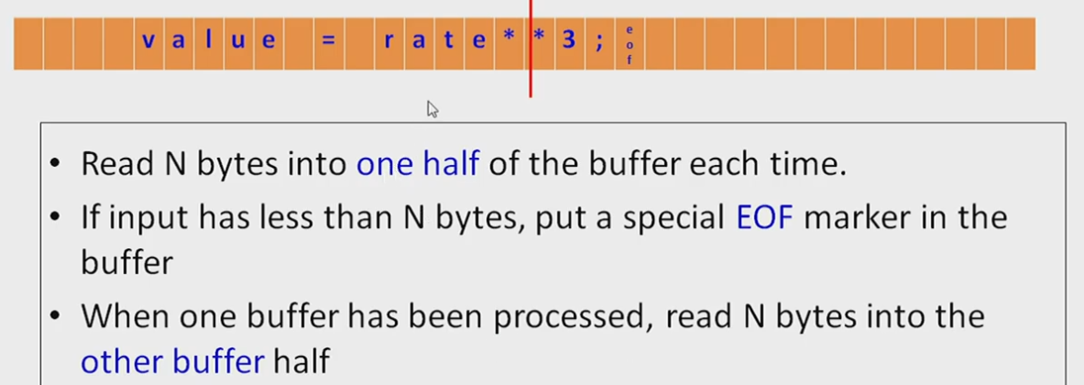

Slide 14
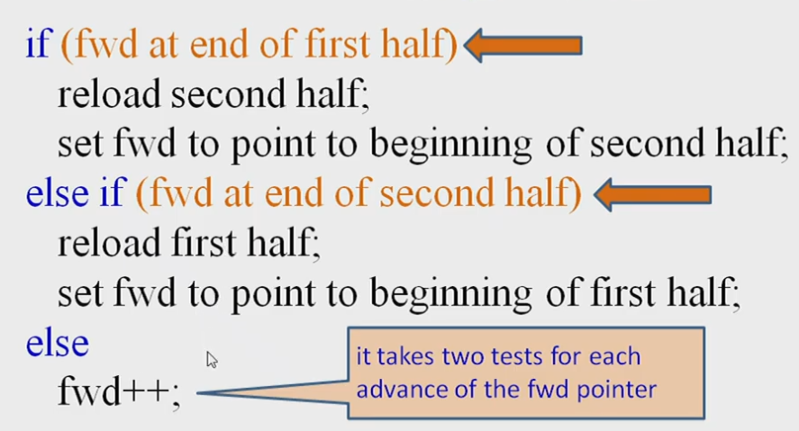
Program Code (buffer pairs)

Slide 15
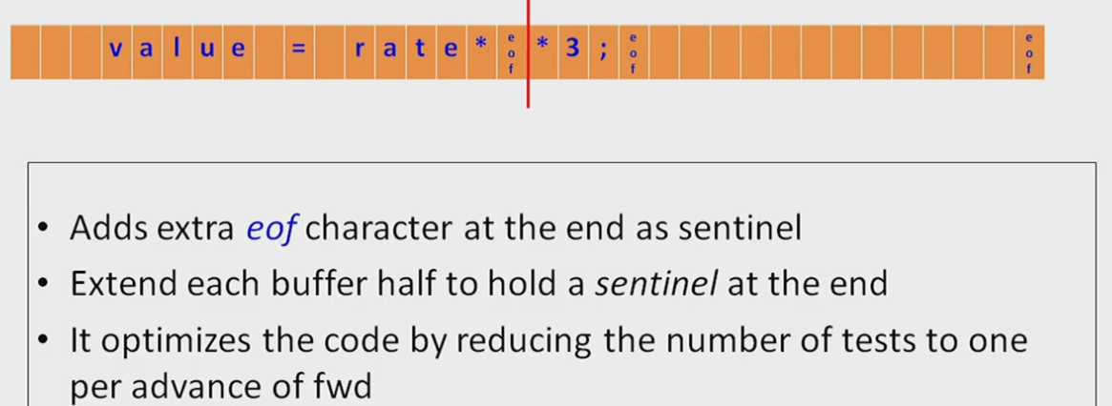
Buffer pairs with sentinels

Slide 16
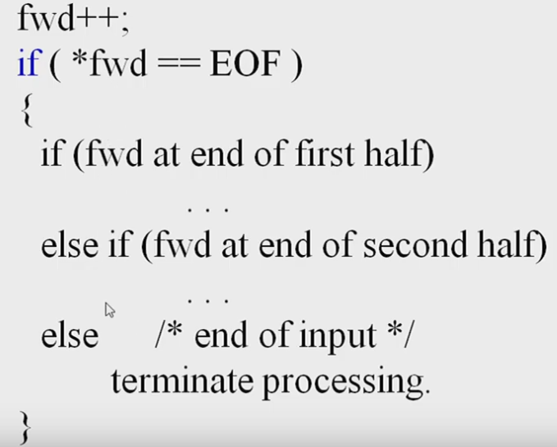
Program code (buffer pairs with sentinels)

Slide 17
Specification of Patterns for Tokens: Terminology
An alphabet Σ is a finite set of symbols (characters)
A string s is a finite sequence of symbols from Σ
|s| denotes the length of string s
ε denotes the empty string, thus |ε| = 0
A language is a specific set of strings over some fixed alphabet Σ

Slide 18
Specification of Patterns for Tokens: String Operations
The concatenation of two strings x and y is denoted by xy
The exponentation of a string s is defined by s⁰ = ε s^{i} = s^{i-1}s for i > 0 (note that sε = εs = s)

Slide 19
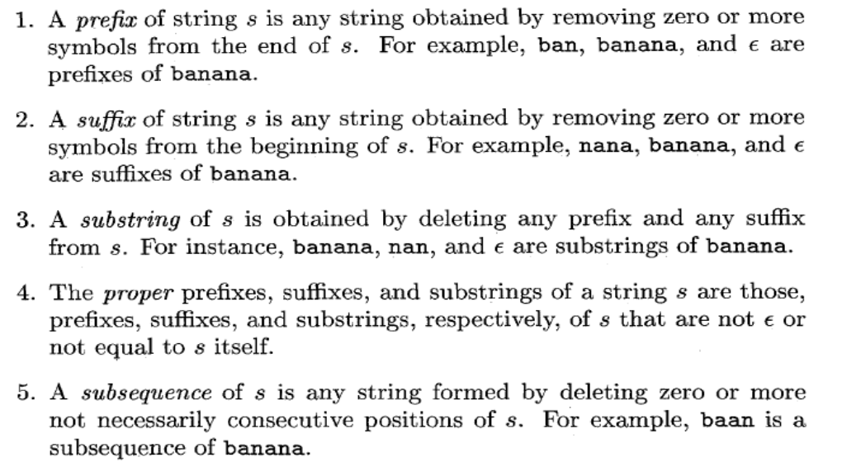
Terms of parts of strings

Slide 20
Specification of Patterns for Tokens: Language Operations
Union L ∪ M = {s | s ∈ L or s ∈ M}
Concatenation LM = {xy | x ∈ L and y ∈ M}
Exponentiation L⁰ = {ε}; L^{i} = L^{i-1}L
Kleene closure L* = ∪_{i=0,…,∞} L^{i}
Positive closure L⁺ = ∪_{i=1,…,∞} L^{i}

Slide 21
Specification of Patterns for Tokens: Regular Expressions
Basis symbols:
ε is a regular expression denoting language {ε}
a ∈ Σ is a regular expression denoting {a}
If r and s are regular expressions denoting languages L(r) and M(s) respectively, then
r | s is a regular expression denoting L(r) ∪ M(s)
rs is a regular expression denoting L(r)M(s)
r* is a regular expression denoting L(r)*
(r) is a regular expression denoting L(r)
A language defined by a regular expression is called a regular set

Slide 22
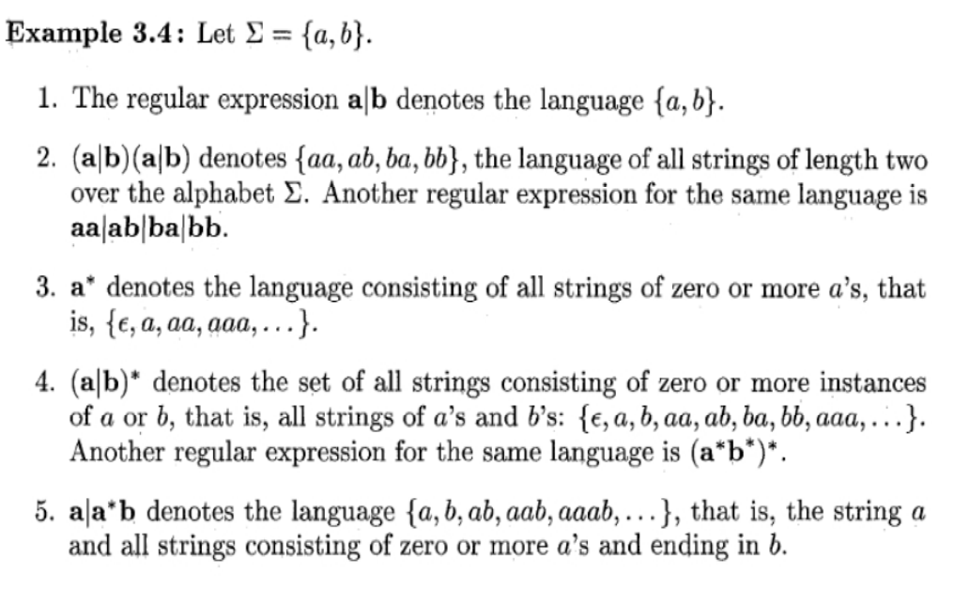
Example

Slide 23
Specification of Patterns for Tokens: Regular Definitions
Naming convention for regular expressions: d₁ → r₁ d₂ → r₂ … d_{n} → r_{n} where r_{i} is a regular expression over Σ ∪ {d₁, d₂, …, d_{i-1} }
Each d_{j} in r_{i} is textually substituted in r_{i}

Slide 24
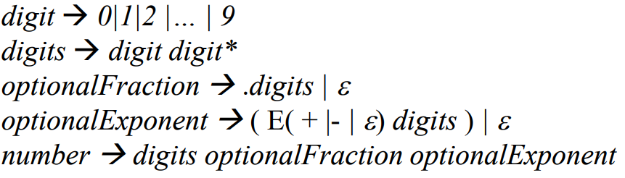
Specification of Patterns for Tokens: Regular Definitions
Example 1: For identifiers - letter → A | B | … | Z | a | b | … | z digit → 0 | 1 | … | 9 id → letter ( letter | digit )*
Example 2: For unsigned numbers-
Example 3: For whitespace-
delim → blank | tab | newline ws → delim⁺
Cannot use recursion, this is illegal: digits → digit digits | digit

Slide 25
Specification of Patterns for Tokens: Notational Shorthands
We frequently use the following shorthands: r⁺ = rr* r? = r | ε [a-z] = a | b | c | … | z
For example: digit → [0-9] number → digit⁺ (. digit⁺)? ( E (+|-)? digit⁺ )?

Slide 26
Regular Definitions and Grammars
Grammar
stmt → if expr then stmt | if expr then stmt else stmt | ε expr → term relop term | term term → id | num
Regular definitions
if → if then → then else → else relop → < | <= | <> | > | >= | = id → letter ( letter | digit )* number → digit⁺ (. digit⁺)? ( E (+|-)? digit⁺ )?

Slide 27
Implementing a Scanner Using Transition Diagrams
relop → < | <= | <> | > | >= | =
start
<
=
0
1
2
return(relop, LE)
>
3
return(relop, NE)
other
*
4
return(relop, LT)
=
5
return(relop, EQ)
>
=
6
7
return(relop, GE)
other
*
8
return(relop, GT)
id → letter ( letter | digit )*
letter or digit
start
letter
other
*
9
10
11
return(gettoken(), install_id())

Slide 28
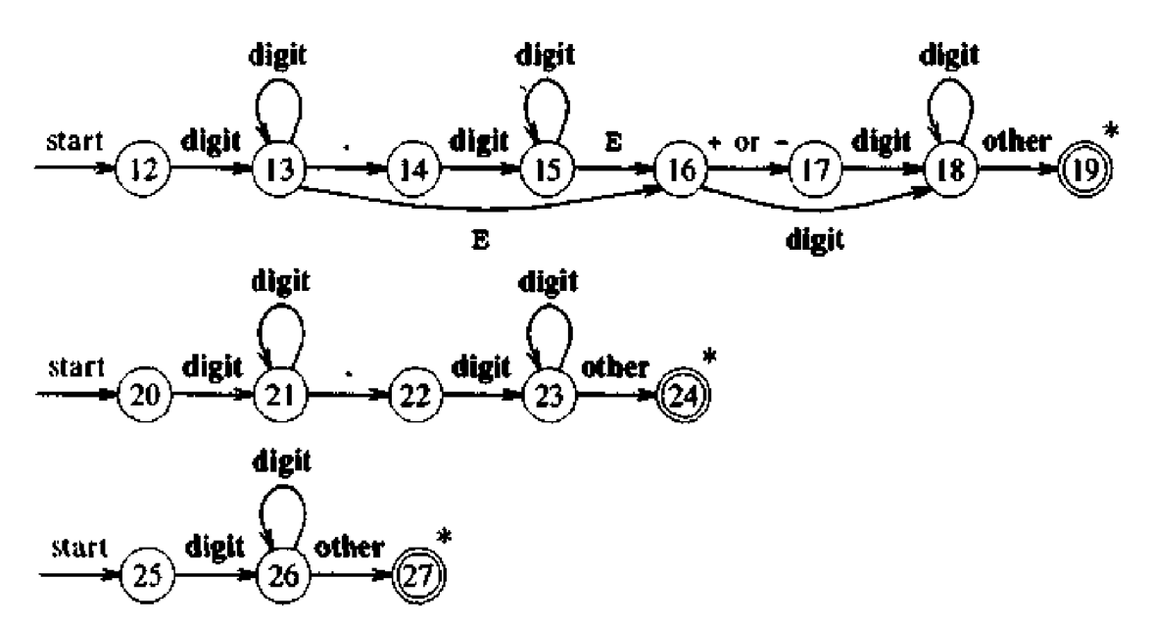
Implementing a Scanner Using Transition Diagrams (contd.)

Slide 29
Implementing a Scanner Using Transition Diagrams (Code)
token nexttoken() { while (1) { switch (state) { case 0: c = nextchar(); if (c==blank || c==tab || c==newline) { state = 0; lexeme_beginning++; } else if (c==‘<‘) state = 1;
else if (c==‘=‘) state = 5; else if (c==‘>’) state = 6; else state = fail(); break; case 1: … case 9: c = nextchar(); if (isletter(c)) state = 10; else state = fail(); break; case 10: c = nextchar(); if (isletter(c)) state = 10; else if (isdigit(c)) state = 10; else state = 11; break; …
Decides what other start state is applicable
int fail() { forward = token_beginning;
swith (start) { case 0: start = 9; break;
case 9: start = 12; break; case 12: start = 20; break; case 20: start = 25; break; case 25: recover(); break; default: /* error */
}
return start;
}

Slide 30
Thank you!!!

